Slide 1
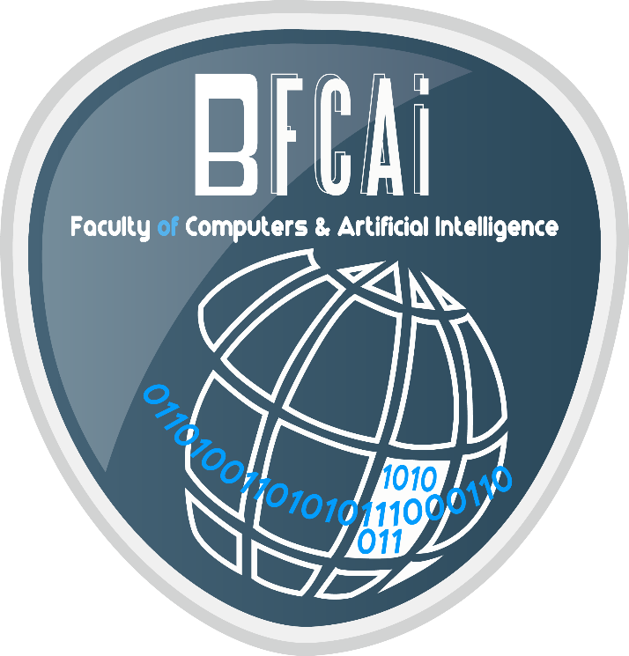

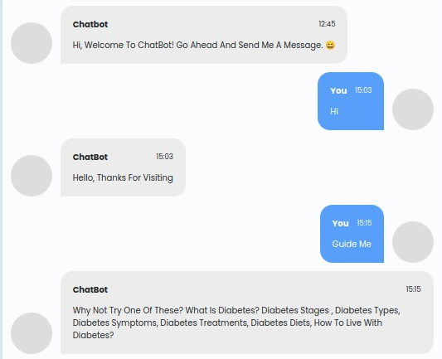
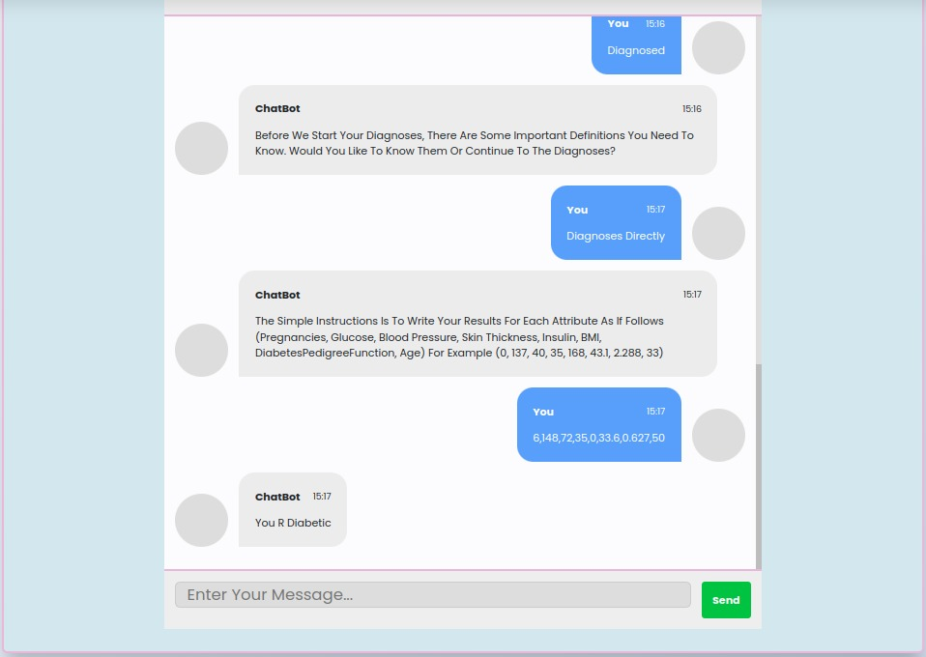
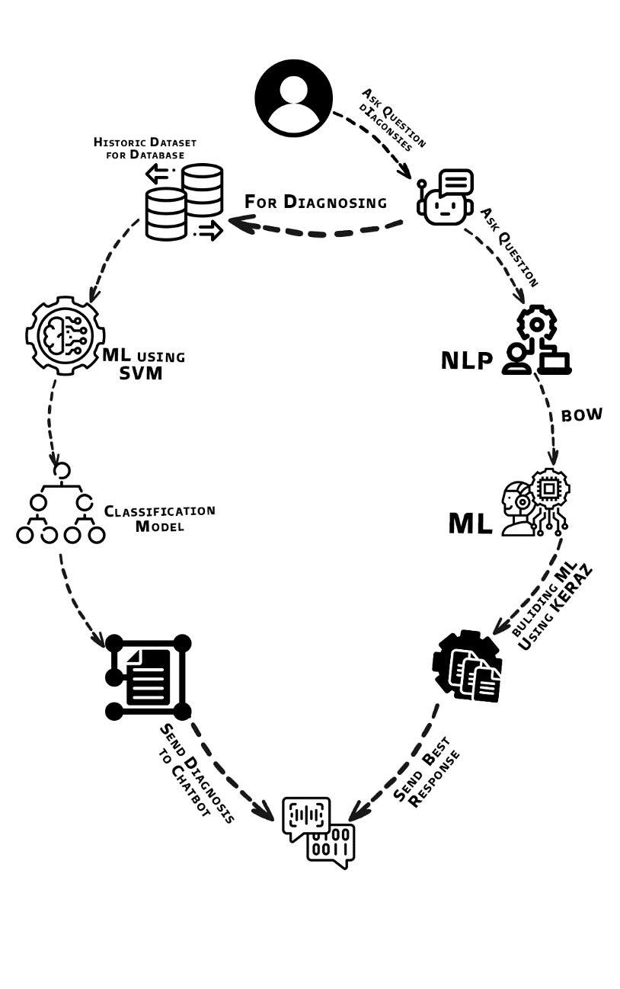
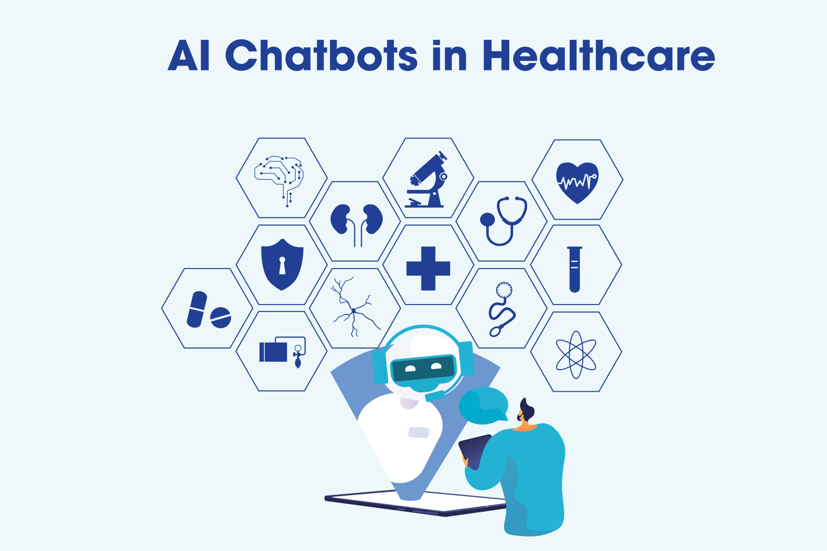

Chatbot for Medical Diagnosis System
Ali Said Lotfy – Abdelwahab Elshennawy – Khaled Ahmed – Mohamed Tamer – Maryam Mahmoud – Mostafa Tarek
Faculty of Computers & Artificial Intelligence
Assoc. Prof. Noha El-Attar
Information Systems Program
Benha University
Abstract
Material & Methods
Classification
Conclusion and Future work
AI in healthcare Provides Machine Learning interfaces that are used to reduce human labor by quickly accessing, analyzing, and providing healthcare to users with a list of probable diagnoses.
Software applications (chatbots) that use textual conversational media are becoming increasingly common in healthcare entities.
In addition, through the lack of medical diagnoses chatbots globally, we were inspired to construct a simple, friendly, and interactive one. Chatbots have the potential to transform healthcare, by significantly increasing the efficiency and accuracy of symptom detection and disease diagnosis, preventative care, post-recovery care, and feedback operations.
In this project, we offer a one-to-one consultation to users to avoid the wait that occurs in healthcare institutes due to the shortage of medical staff. After analyzing users’ data and inputs, the Chatbot provides a proper response to their concerns or suggests treatments around the clock.
That is through two models that will analyze the responses and provide the user with the most suitable outcomes, based on datasets that the models used to train and test.
The user can query basic information regarding the illness he/she has concerns about, and according to it, the Chatbot responds.
Queries can be about what is the illness, its symptoms, stages or types, the treatments available, how it can be diagnosed and that’s what the chatbot helps out the most, and finally, the lifestyle and diet to follow according to the illness.
Chatbot PSEUDOCODE:-
Step 1: Insert user query in the chatbot window. (INPUT)
Step 2:Pre-processing of the query
Step 3: Fetch only keywords from the query.
Step 4: Chatbot stores the session Information in its log.
Step 5: Processes the Command. Matches the fetched keywords with the keywords in Knowledge base, and provides an appropriate response. A keyword matching algorithm is used to process the query.
Step 6: The response is fetched from the knowledge base and returned as an output to the user.
Step 7: Exit.
The chatbot works on two models, the first is Bag_of_words model that analyze texts entered by user and respond by the appropriate responses specified by tags in the dataset that the model is trained on.
The other one is classification by support vector machine (SVM), which is specially used for taking user’s inputted numbers for providing proper diagnoses; this model uses dataset from Kaggle.
The dataset we will be utilizing is 'data.json.' This is a JSON file containing the patterns we need to find and the replies we want to deliver to the user.
The project needs a strong understanding of Python, Keras, and natural language processing (NLTK). Alongside these, we will utilize several helper modules that you can get by using the python-pip command.
The initial stage in the ML process is to prepare the training data.
Our models diagnose illnesses based on test numbers provided by the user, such as :
The number of pregnancies, an oral glucose tolerance test, blood pressure, skin thickness, insulin levels, body mass index, diabetes pedigree function, and finally the age .
Where it’s then according to these numbers, the model compare it with its dataset and classify user to diabetic or non-diabetic.
The project focuses on providing rapid medical services from knowing basic information reaching to diagnoses; this service is conducted through an intelligent chatbot.
The interactions is conducted through a website interface, which also provide general diabetes information all in one place for user to explore.
As for the future work, the focus is on:
Adding more diseases to diagnose
Improving the datasets to have more accurate and precise predictions
Developing android and IOS applications
Improving the models used
Deploying the project on cloud
Integrate voice recognition along with text
Results
Because our primary goal was to facilitate friendly dialogue between the user and the chatbot, we created a very simple yet intelligent interface for their interactions.
The Chatbot's interface:
Assessing model performance:
References
[1] Debadri Dutta, Debpriyo Paul, Parthajeet Ghosh, "Analyzing Feature Importance’s for Diabetes Prediction using Machine Learning". IEEE, pp 942-928, 2018
[2] A.K., Dewangan, and P., Agrawal, “Classification of Diabetes Mellitus Using Machine Learning Techniques,” International Journal of Engineering and Applied Sciences, vol. 2, 2015.
[3] Kazi, Hameedullah & S. Chowdhry, B & Memon, Zeesha. (2012). MedChatBot: An UMLS based Chatbot for Medical Students. International Journal of Computer Applications. 55. 1-5. 10.5120/8844-2886.
[4] "Novel Approach for Medical Assistance Using Trained Chatbot",Divya Madhu, Neeraj Jain C,International Conference on Inventive Communication and Computational Technologies.
[5] V.Manoj Kumar"Sanative Chatbot For Health Seekers",JECS Volume 05 Issue 3 March 2016 Page No.16022-16025.
[6] OWLES,M.,2019.MACHINE LEARNING IN PYTHON.[Place of publicationnot identified]:JOHN WILEY &Sons.
[7]https://scikitlearn.org/stable/modules/svm.html#:~:text=Support%20vector%20machines%20(SVMs)%20are,than%20the%20number%20of%20samples.
[8] https://www.ijcttjournal.org/2018/Volume60/number-1/IJCTT-V60P106.pdf
[9] https://buffml.com/web-based-chatbot-using-flask-api/
[10] https://www.projectpro.io/article/python-chatbot-project-learn-to-build-a-chatbot-from-scratch/429
Objectives
Examine potential symptoms based on AI tools.
Provide guidance rapidly as well as being accessible 24 hours a day, seven days a week.
Improving the patient experience by offering immediate support.
Recommend doctors based on the nearest one to the patient's geographical area.
Improved patient satisfaction.
ACKNOWLEDGMENT
On this project, we worked hard. However, it would not have been possible without the generous support and assistance of many people. We would like to express our heartfelt gratitude to every one of them.
We are grateful to Assoc. Prof. Noha El-Attar for her leadership and ongoing monitoring, as well as for supplying vital project information and assistance in finishing this project.
And we thank Eng. Ibrahim Reyaid for his expert advice and remarks, as well as for providing us with his undivided attention and time.
We do want to express our gratitude to our family for their tremendous assistance and support in completing this project.
Our admiration and respect also go to our colleagues who generously assisted us with their skills.

